Slide 1


Chinook Sales Analysis
Farhaneh Nazemi
Augest 2024

Slide 2


Introduction
Objective
Analysis Result
Dashboard

Slide 3
Objective
The objective of this project is to analyze the Chinook Database to gain insights into the digital media store's operations. We will:
Understand Data Structure : Explore tables and relationships.
Perform SQL Queries : Extract meaningful information.
Generate Insights : Analyze customer behavior and sales trends.
Visualize Data : Create visual representations to support data-driven decisions.
This analysis will help in making informed business decisions and strategies.

Slide 4



Analysis Result

Slide 5
Q1. Get data from My SQL DB
Install SQL Alchemy package
Create .json file include DB configuration
Get all table into separate data frames

Slide 6
Q2. Initial data examination
{df.shape}
{df.columns.tolist()}
{df.dtypes}
{df.isnull().sum()}
{df.describe(include='all')}

Slide 7


Q3,4. Visualizing Key Variables
Revenue
Artist
Customer

Slide 8
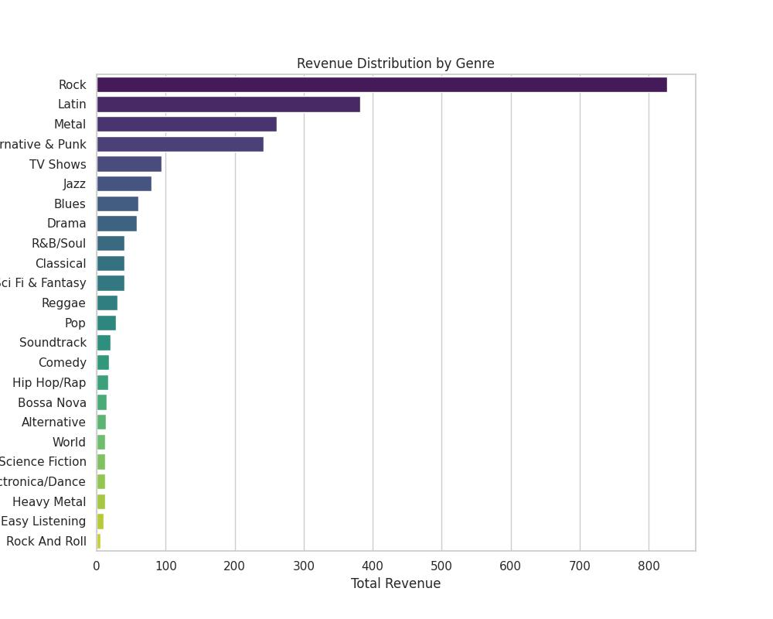
Q3,4. Revenue Analysis

Slide 9
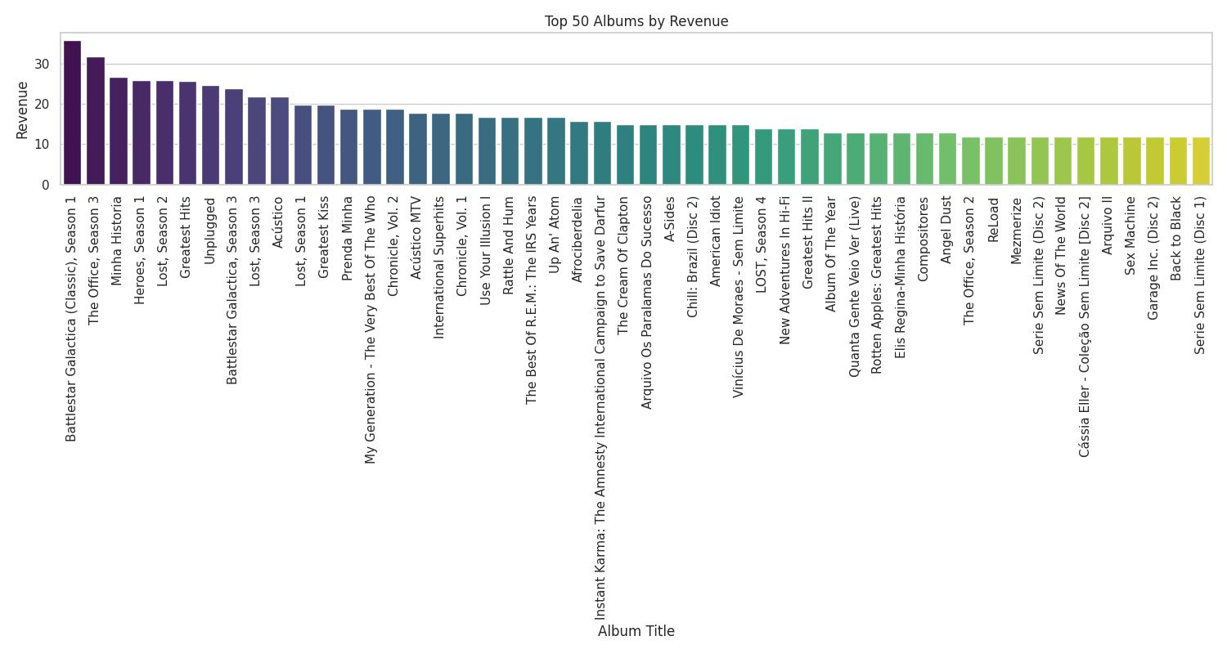
Q3,4. Revenue Analysis

Slide 10
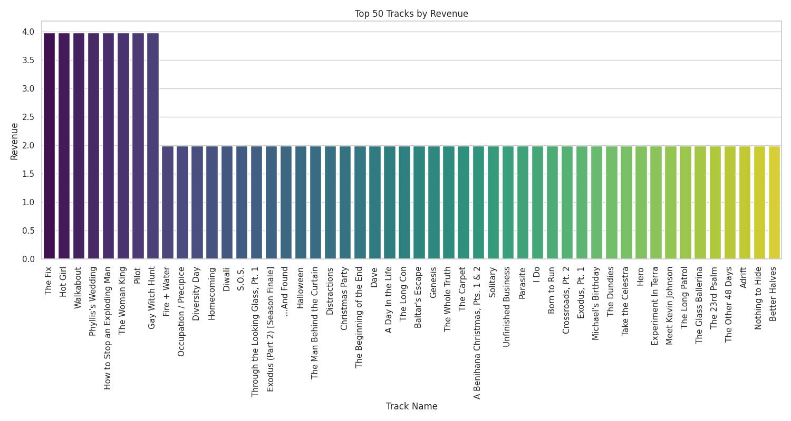
Q3,4. Revenue Analysis

Slide 11
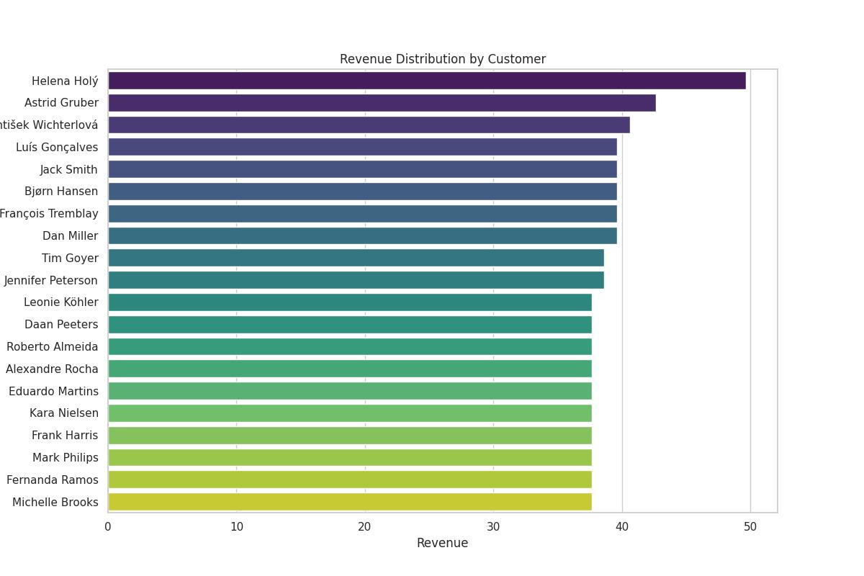
Q3,4. Revenue Analysis

Slide 12
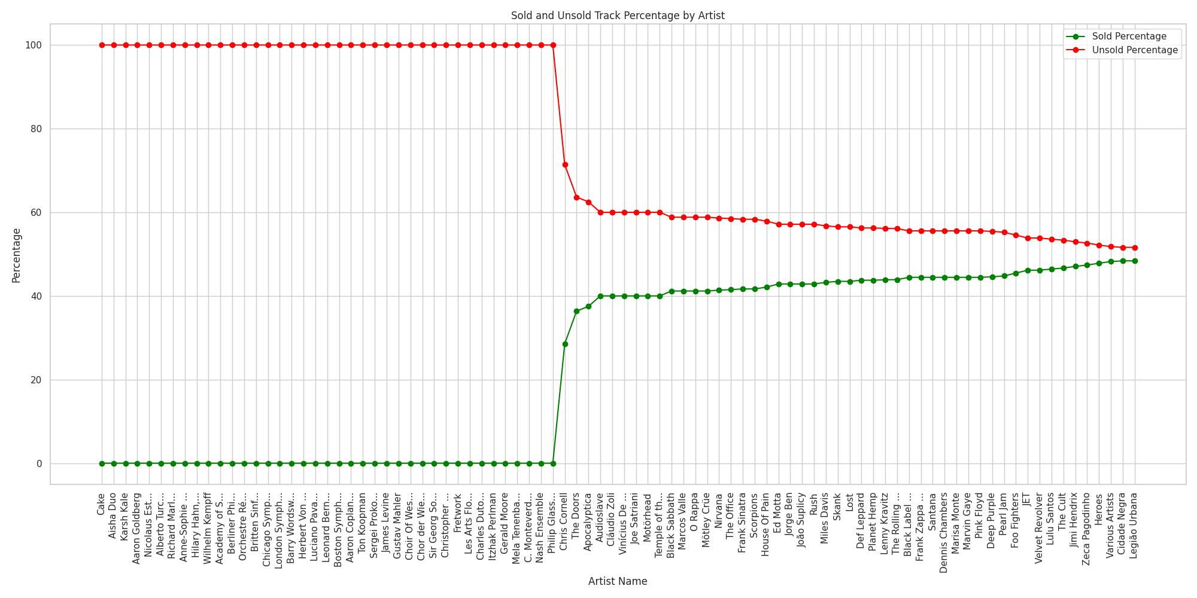
Q3,4. Artist Analysis

Slide 13
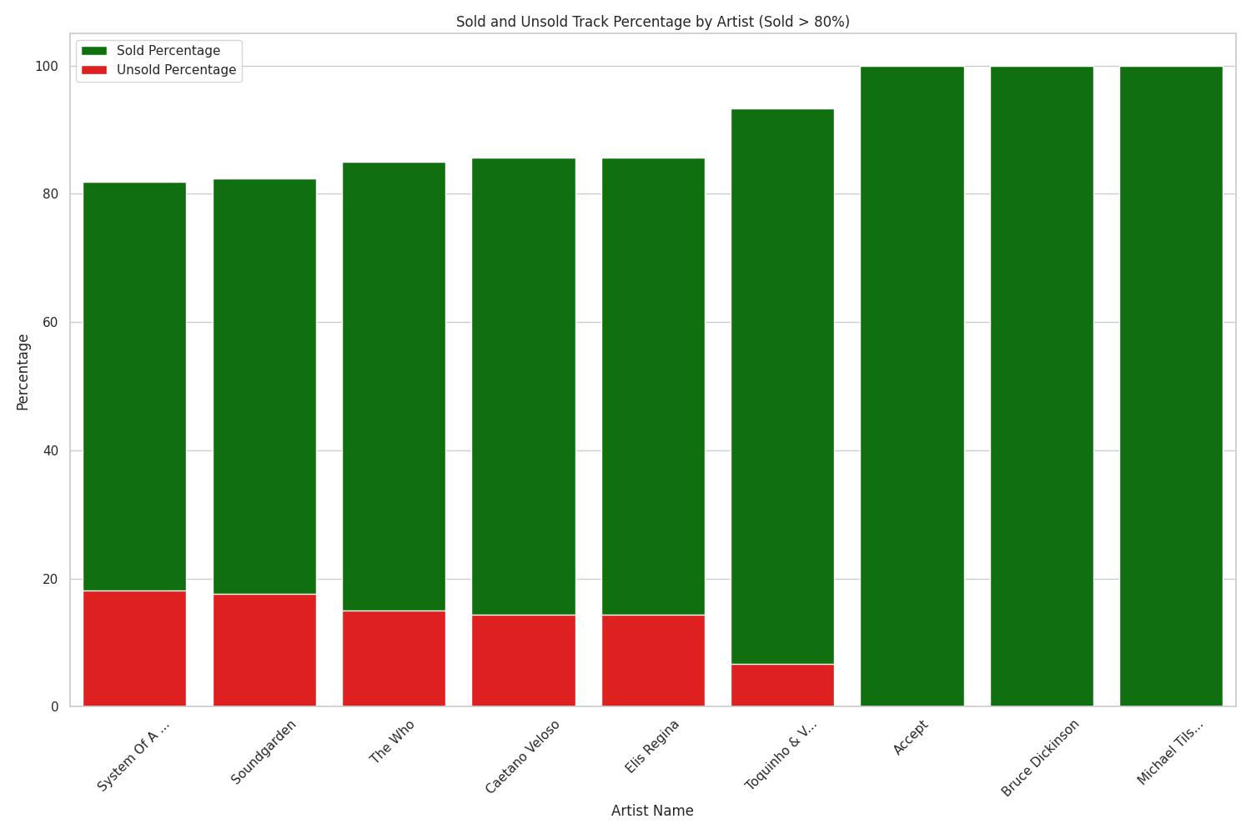
Q3,4. Artist Analysis

Slide 14
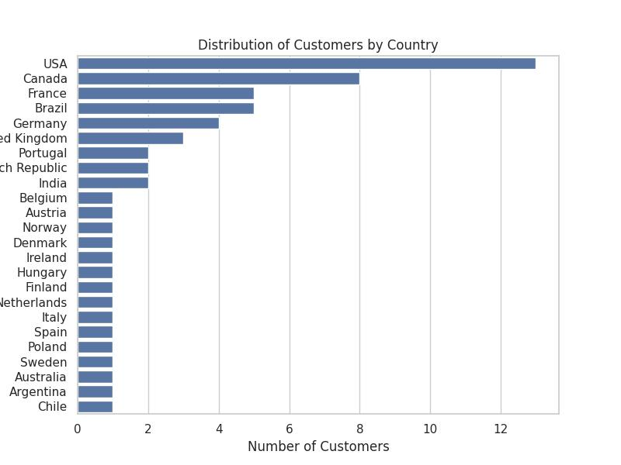
Q3,4. Customer Analysis

Slide 15
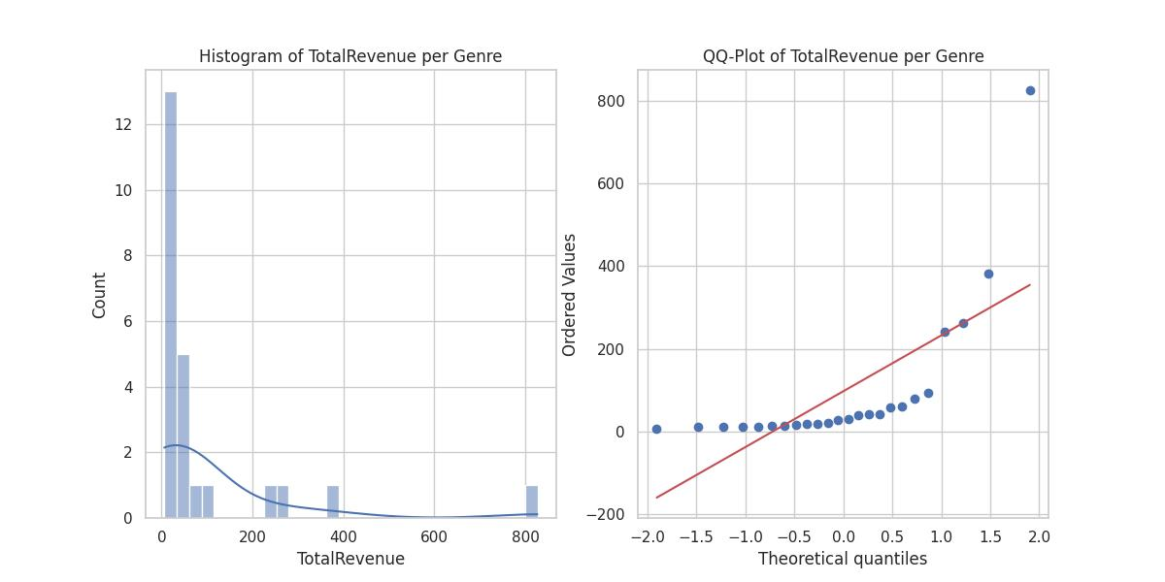
Q5. Check Normality of Data Using Plots

Slide 16
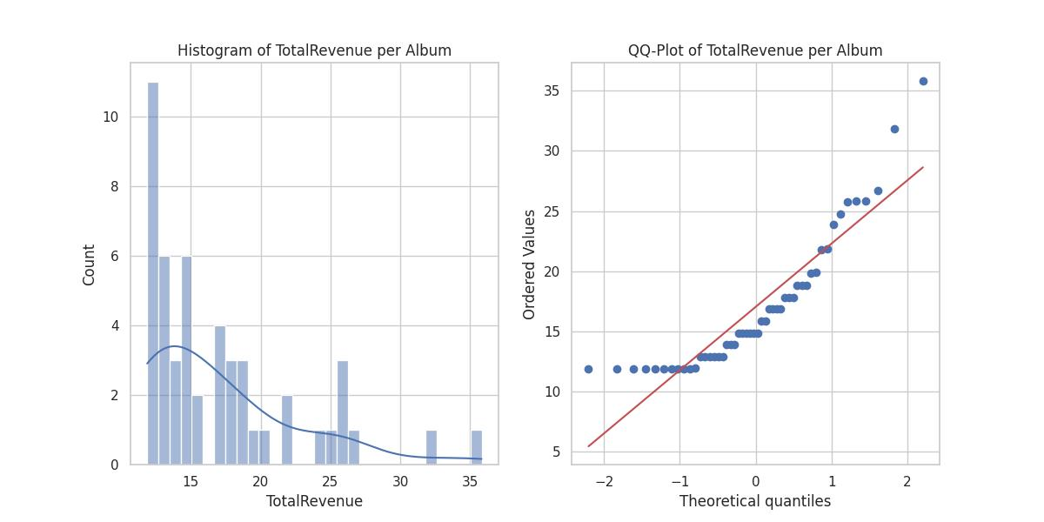
Q5. Check Normality of Data Using Plots

Slide 17
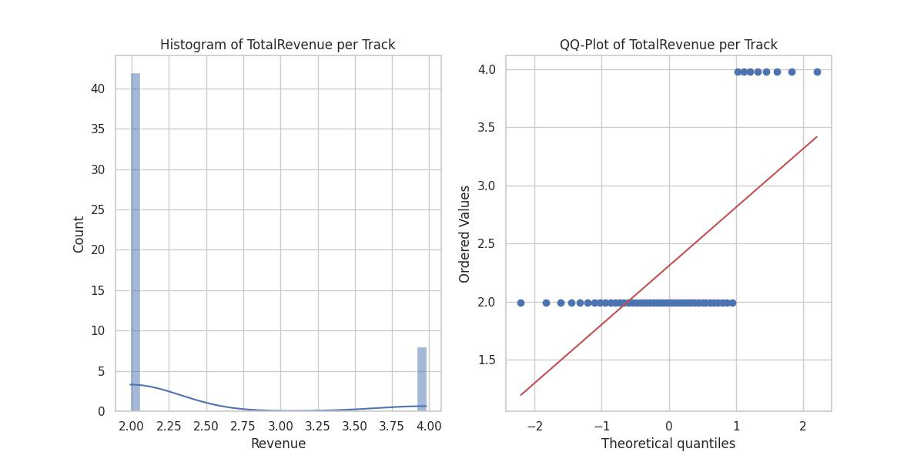
Q5. Check Normality of Data Using Plots

Slide 18
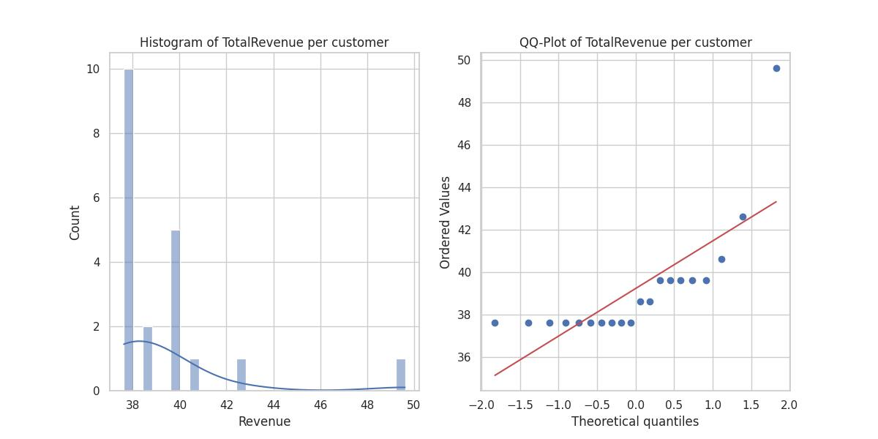
Q5. Check Normality of Data Using Plots

Slide 19
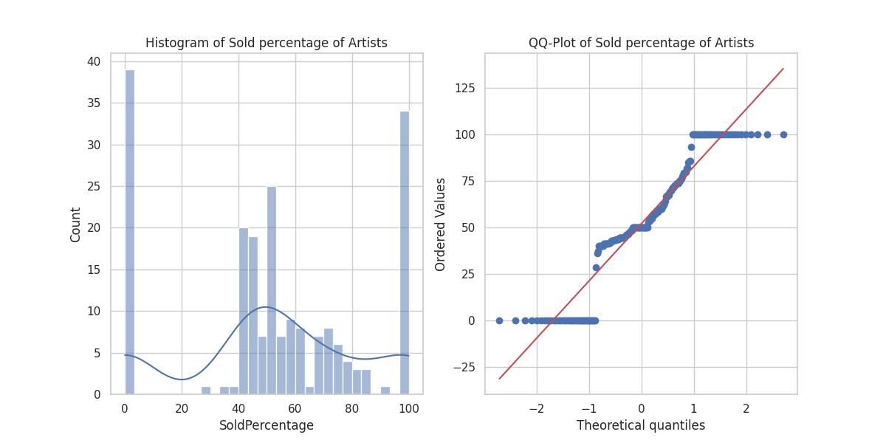
Q5. Check Normality of Data Using Plots

Slide 20
Q5. Check Normality of Data Using Statistical Tests
Shapiro-Wilk Test
Kolmogorov-Smirnov Test
D'Agostino's K^2 Test
Reject the null hypothesis: The data does not appear to be normally distributed.

Slide 21
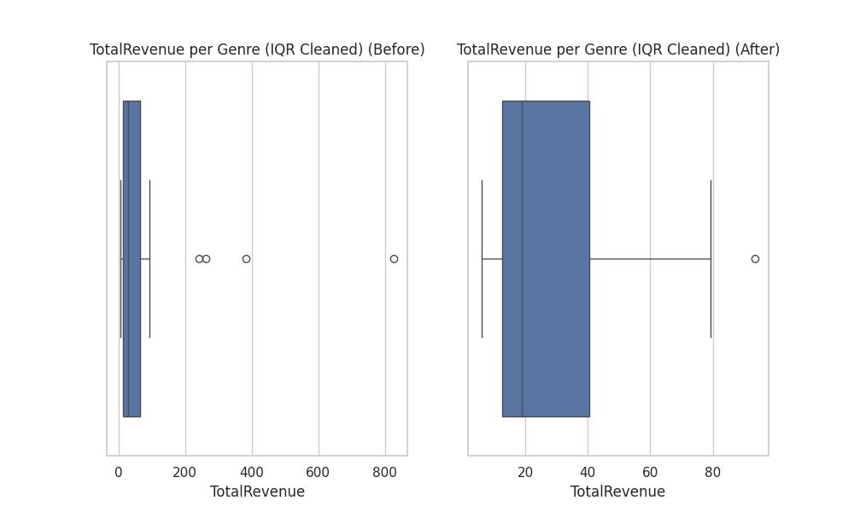
Q6. Cleaning Outlier Data

Slide 22
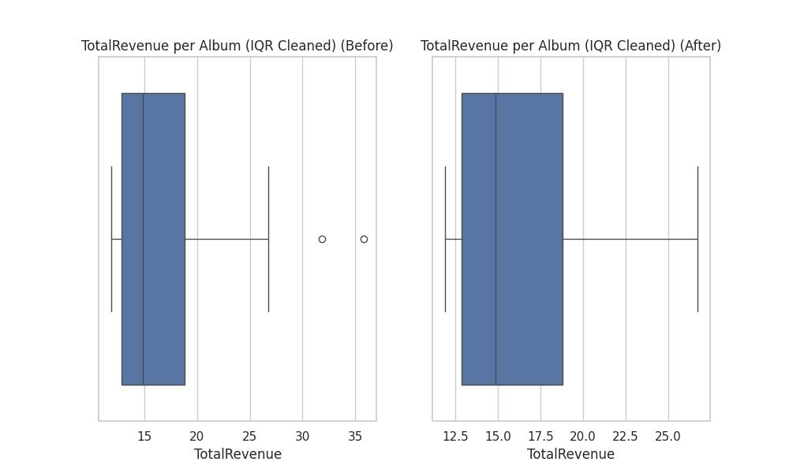
Q6. Cleaning Outlier Data

Slide 23
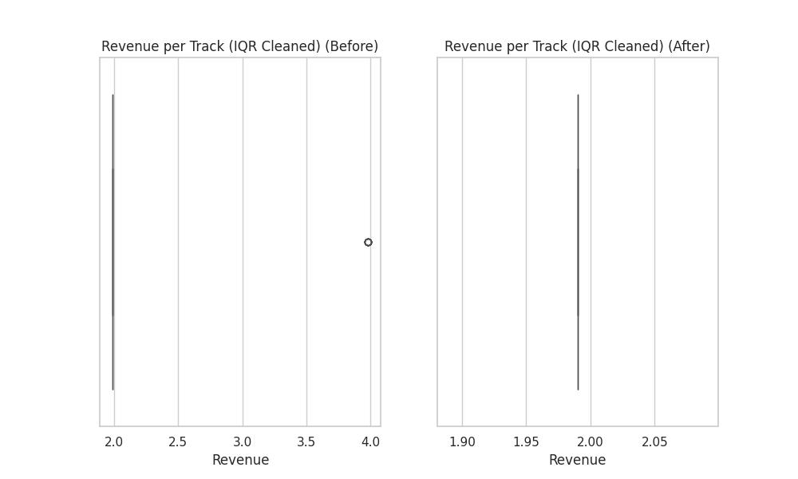
Q6. Cleaning Outlier Data

Slide 24
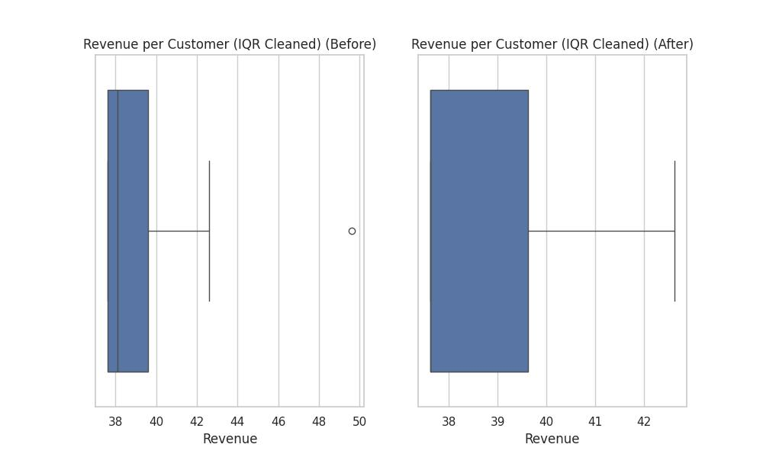
Q6. Cleaning Outlier Data

Slide 25
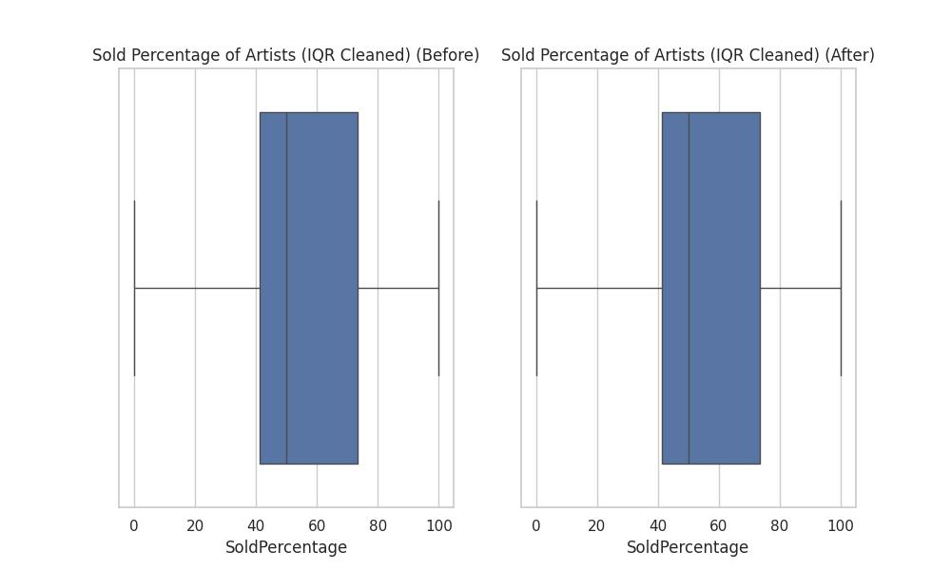
Q6. Cleaning Outlier Data

Slide 26
Q7. Correlation Between Mean Unit Price among the top Genres
Name | Total Revenue | Unit Price
Rock | 826.65 | 0.99
Latin | 382.14 | 0.99
Metal | 261.36 | 0.99
It means that there's no variability in the prices, and hence, statistical tests like ANOVA or Kruskal-Wallis won't be useful since they require variability to compare means.

Slide 27
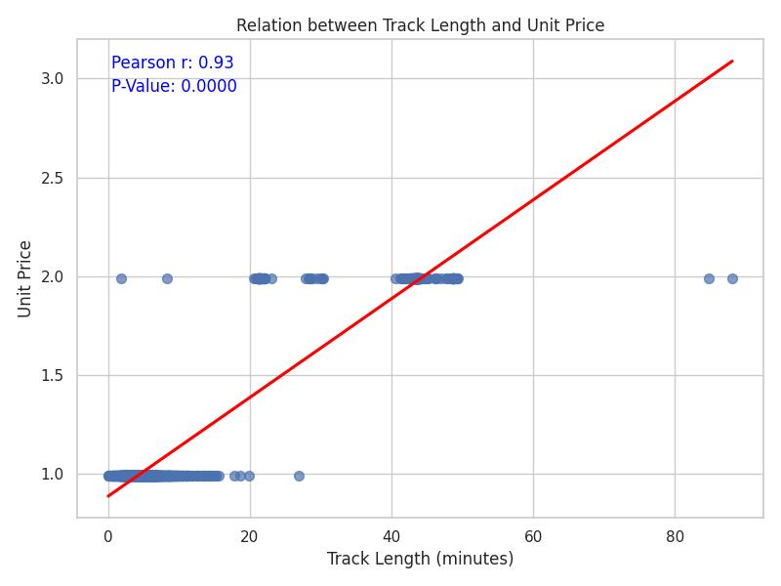
Q7. Correlation Between Track Length and Unit Price
Pearson Reject the null hypothesis: There is a significant correlation between track length and unit price.

Slide 28
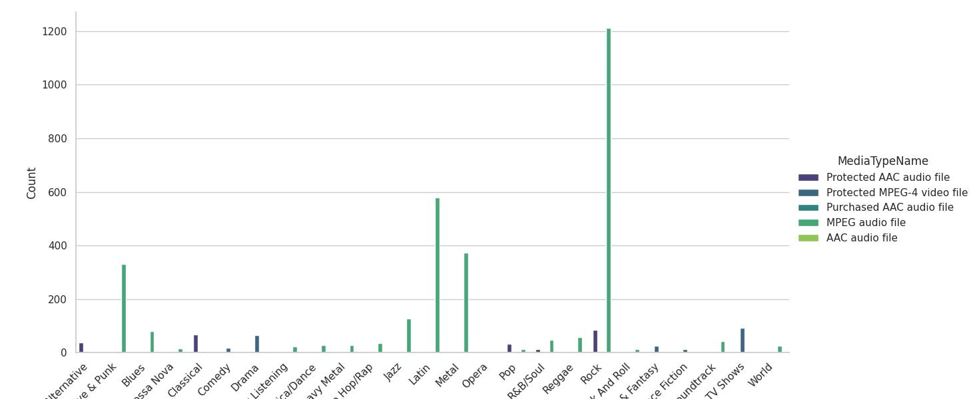
Q7. Association Between Genre and Media Type
Chi2
Reject the null hypothesis: There is a significant association between genre and media type.

Slide 29

Q7. Additional Findings
1. Relationship between Track Count and Genre
2. Correlation Between Track Count and Revenue of album
3. Correlation between Track Duration and Revenue of top tracks

Slide 30
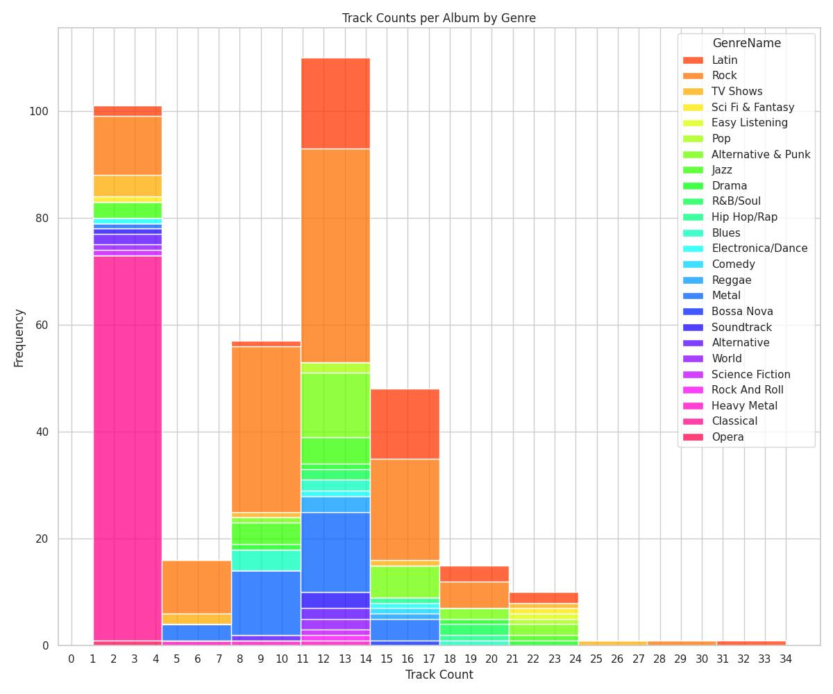
Q7. There is a significant relationship between Track Count and Genre. (Chi-Square)

Slide 31
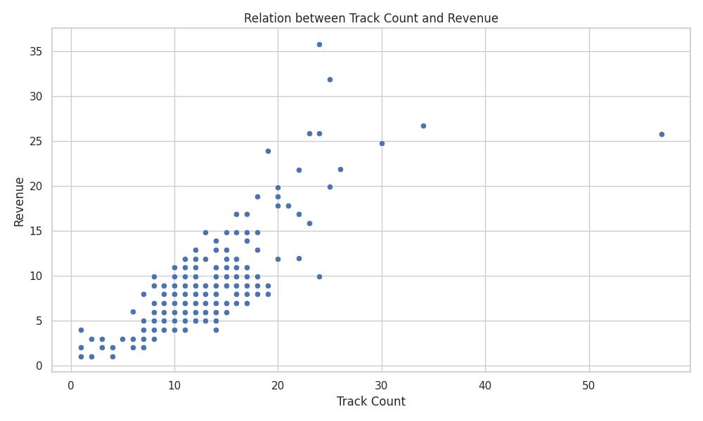
Q7. Correlation between Track Count and Revenue of album : 0.82

Slide 32
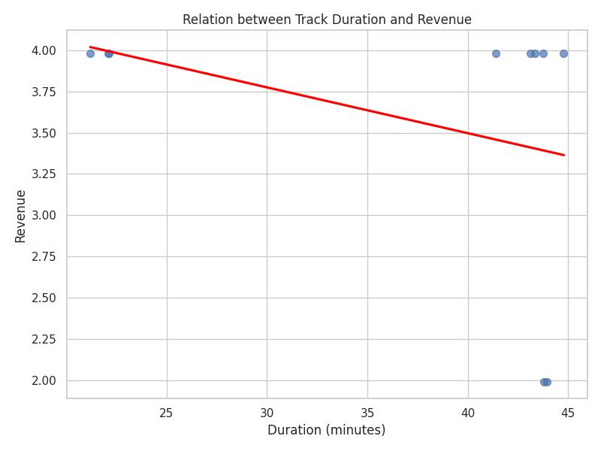
Q7. Correlation between Track Duration and Revenue of top tracks: -0.35

Slide 33
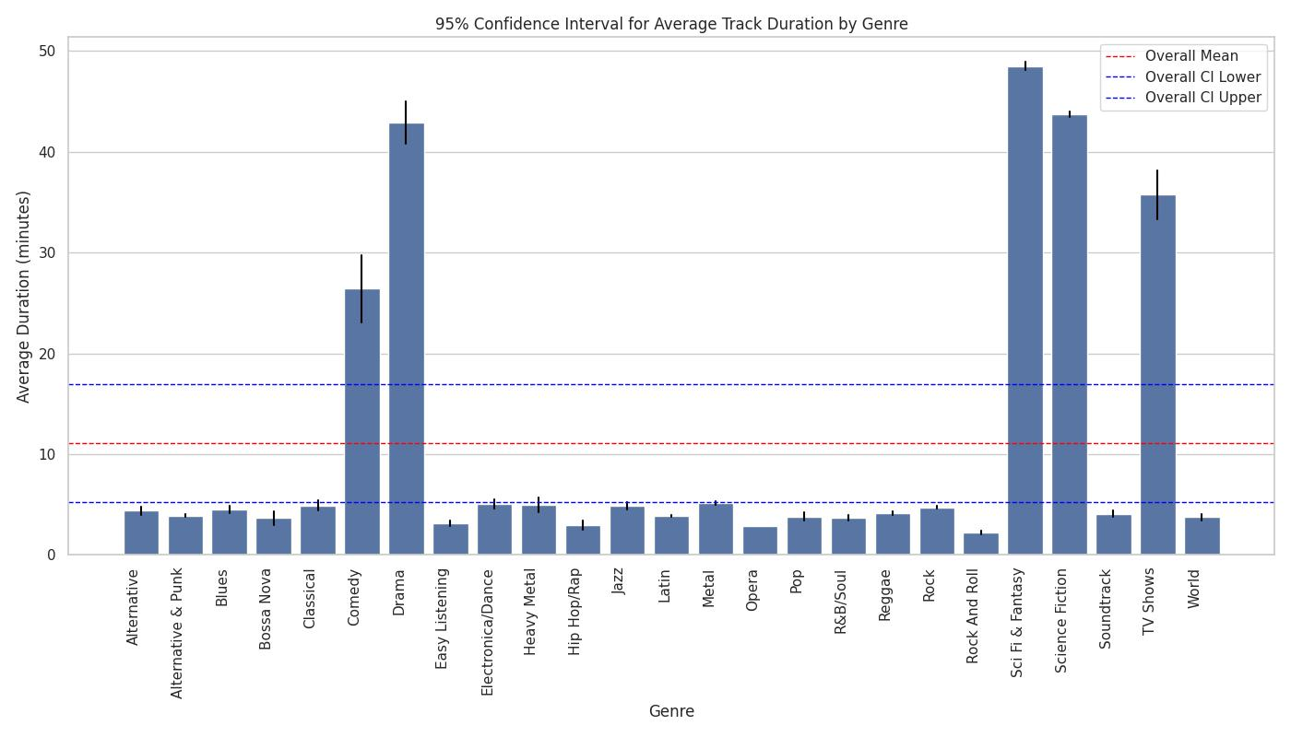
Q8. 95% Confidence Interval for Average Track Duration by Genre

Slide 34
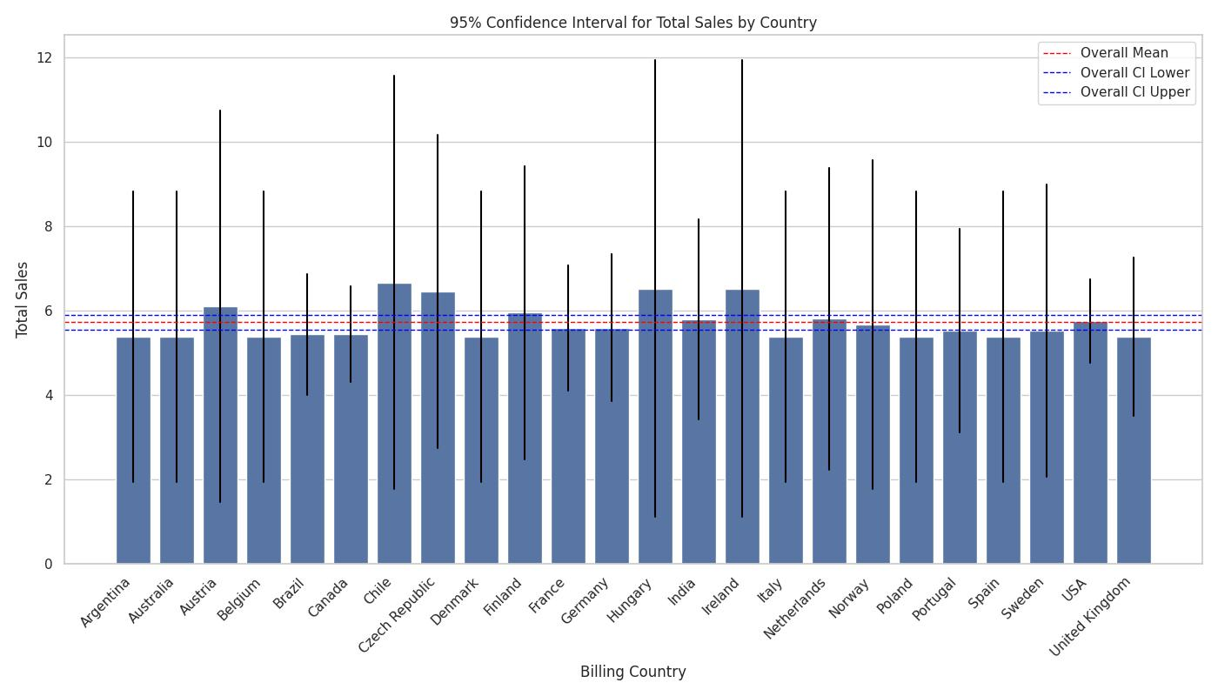
Q8. 95% Confidence Interval for Total Sales by Country

Slide 35
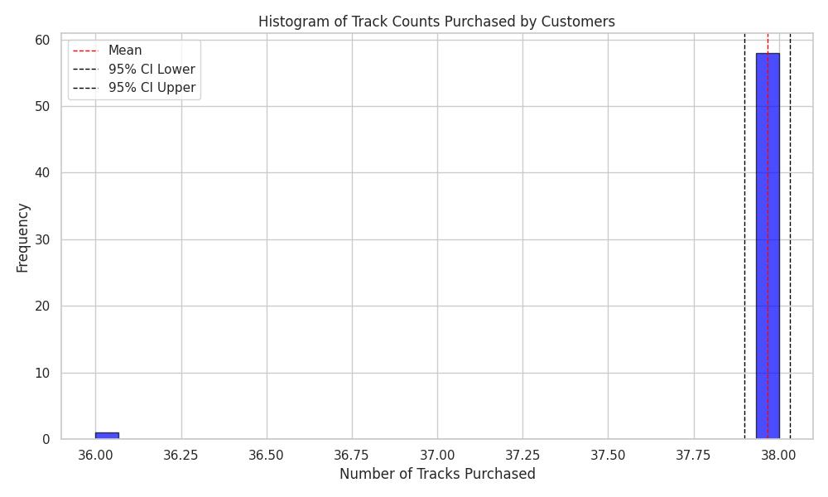
Q8. 95% Confidence Interval for Track Counts Purchased by Customers
Mean Track Count: 37.97 , 95% Confidence Interval: (37.90, 38.03)

Slide 36
Dashbord

Slide 37
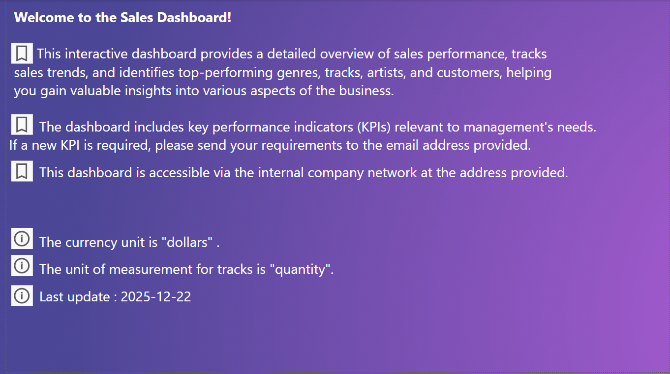
Home Page

Slide 38
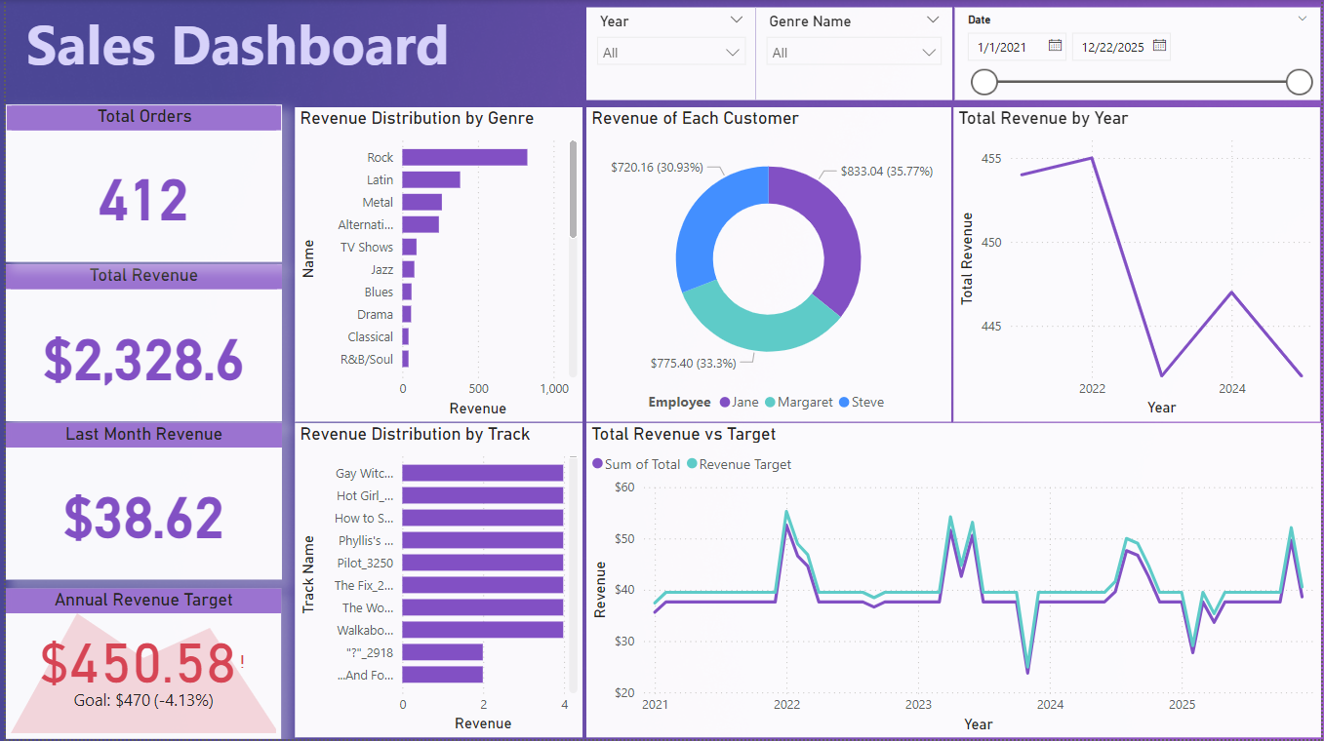
Overview

Slide 39
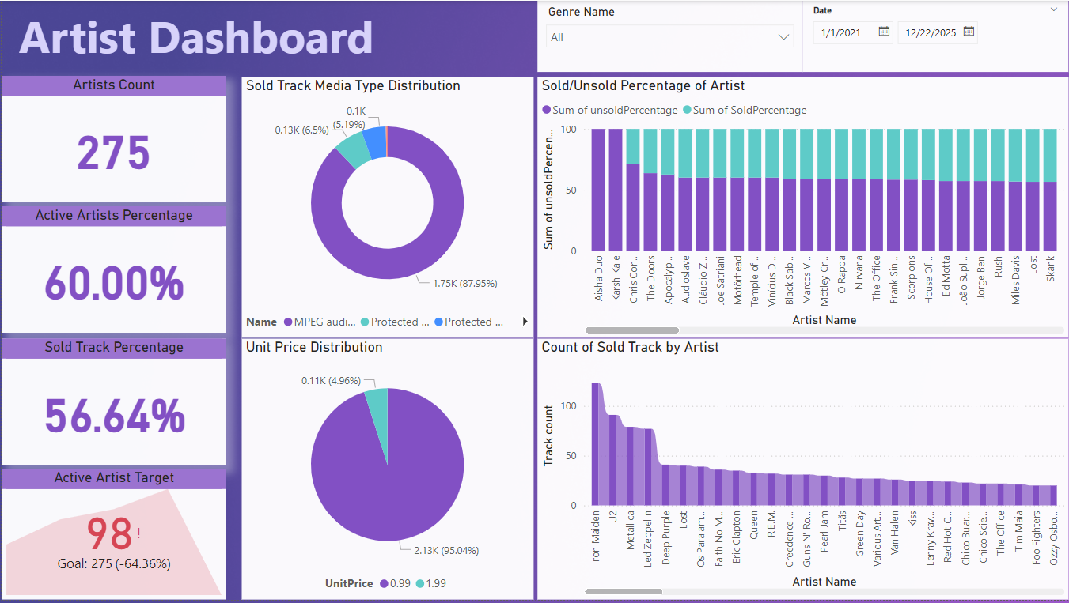
Artist

Slide 40
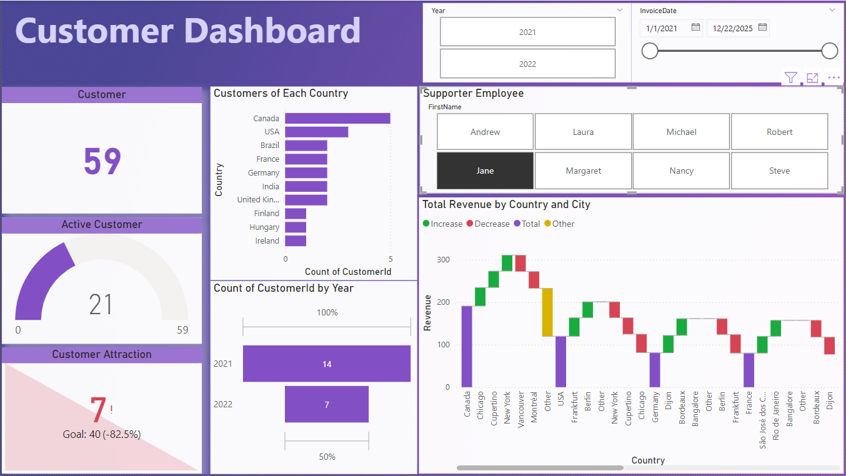
Customer

Slide 41

Thanks for your attention.

